Slide 1
2020 Election Update
August 26, 2020

Slide 2
United States Senate

Slide 3
2020 Election Update: 116th Congress: Senate

Slide 4
2020 Election Update: Senate Races
Republicans currently hold a slim majority with 53 seats
Democrats need a net four seats to take control, but only 3 seats if Vice President Biden wins the Presidency
35 Senate seats are in-cycle this year
23 held by Republicans
12 held by Democrats
Presidential Race Impact:
2016: President Trump carried all but two states where Republicans are defending Senate seats in 2020
He won 15 of those states by at least 14 percentage points

Slide 5
2020 Election Update: Senate Races
Notes: Pat Roberts (R-Kan.), Tom Udall (D-N.M.), Lamar Alexander (R-Tenn.) and Mike Enzi (R-Wyo.) are retiring; McSally was appointed to fill the remainder of John McCain’s (R) term and is running in a special election that will occur in 2020 and the seat also will be on the ballot in 2022; Loeffler, who was sworn in Jan. 6 to succeed Johnny Isakson (R), is running in a November 2020 special election to fill the remaining two years of the unexpired term
Source: U.S. Senate; Bloomberg Government

Slide 6
2020 Election Update: Senate Races
Source: U.S. Senate; Bloomberg Government
Note: Georgia has one regularly scheduled election and one special election; Arizona has a special election

Slide 7
2020 Election Update: Senate Forecast

Slide 8
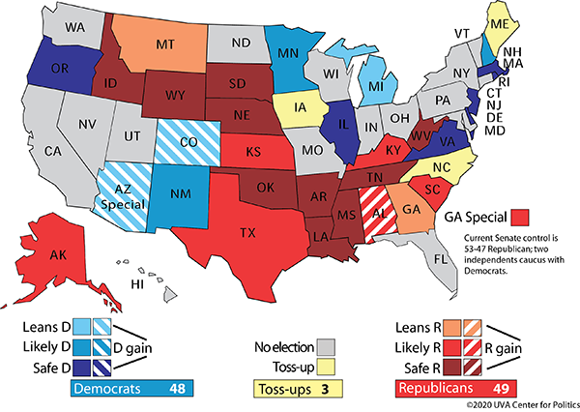
2020 Election Update: Senate Race Sabato’s Crystal Ball

Slide 9
United States House of Representatives

Slide 10
2020 Election Update: 116th Congress: House of Representatives

Slide 11
2020 Election Update: House of Representatives
Democrats are expected to keep their majority in a presidential election year
DCCC Frontline Program: targeted 42 seats to aggressively defend
DCCC Red to Blue: additional 31 seats that Democrats are looking to gain
Many of these districts include suburban, rapidly changing demographics
NRCC target races: House GOP is targeting 50 seats—including 30 districts that President Trump won in 2016
So far this year, 8 House incumbents have lost their seats in primary elections

Slide 12
2020 Election Update: House Casualty List (Bloomberg Government)

Slide 13
2020 Election Update: House of Representatives Cook Ratings

Slide 14
2020 Election Update: House of Representatives Sabato’s Crystal Ball
Democrats who represent districts Donald Trump won in 2016

Slide 15
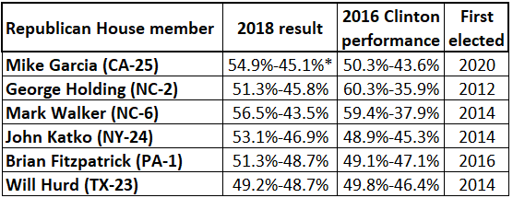
2020 Election Update: House of Representatives Sabato’s Crystal Ball
Republicans who represent districts Hillary Clinton won in 2016

Slide 16
Presidential Election

Slide 17
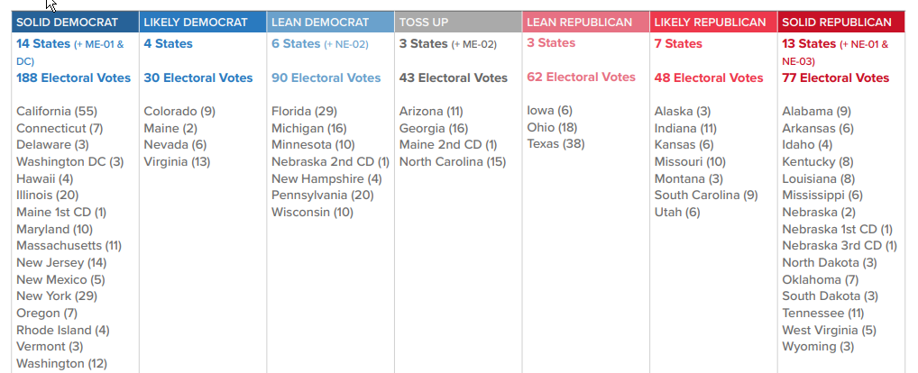
2020 Election Update: Presidential Race: Electoral College
Trump won electoral vote 304-227, lost the popular vote by 2.1 points
Cook’s Latest Scenario: 308 – Biden/Democratic | 43 - Toss Up | 187 - Trump/Republican
Source: Nominees need 270 electoral votes to win; race ratings from Cook Political Report via Bloomberg Government

Slide 18
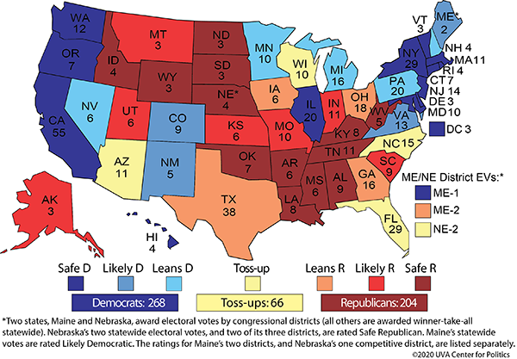
2020 Election Update: Presidential Race: Sabato’s Crystal Ball

Slide 19
2020 Election Update: Presidential Race: 270 to Win
2016 Electoral Math:
Trump: 304 electoral votes (306 counting 2 faithless)
Clinton: 227 electoral votes (232 counting 5 faithless)
3 crucial states where changes in 2020 could secure the race for Vice President Biden:
Pennsylvania: 20 electoral votes
2016: Trump won by <1% of the votes
Michigan: 16 electoral votes
2016: Trump won by <0.3% of the votes
Wisconsin: 10 electoral votes
2016: Trump won by <1% of the votes
If Biden wins these three states and everything else remains the same as in 2016, Biden wins 278-260.

Slide 20
2020 Election Update: Presidential Race: Additional Battleground States
Florida:
29 electoral votes
2016: Trump won by 1.2% of the votes
Arizona:
11 electoral votes
2016: Trump won by 3.5% of the votes
Minnesota:
10 electoral votes
2016: Clinton won by 1.5%
North Carolina:
15 electoral votes
2016: Trump won by 3.7% of the votes

Slide 21
2020 Election Update: Democratic National Convention Aug. 17-20: Primarily Virtual; host city: Milwaukee, WI

Slide 22
2020 Election Update: Republican National Convention Aug. 24-27: Multiple Locations; host city: Charlotte, NC

